Slide 1

Virtual Study Rooms

Slide 2

Content
Aim
Objective
Problem Identification
Domain
Tools
Model
Proposed Methodology
Dataset
Advantages and Limitations
References
Conclusion

Slide 3
Aim
To create virtual study spaces for students and readers.
Recommend study rooms according to subject of interest so that students can connect globally with students studying similar topics.
Minimize distractions by integrating video player and pdf readers in study rooms.
Personalized book recommendation according to interests and subjects.

Slide 4
Objective
Create study rooms using web sockets that enable chat.
Build at least 4 models and select the one with least false positive rate for book recommendation and room recommendation respectively.
Integrate pdf reader and video player
Create interactive website in MERN Stack.

Slide 5
Problem Identification and Solution
There are multiple book recommendations but none is personalized for users.
Study rooms are not global. For example, current systems allow you to create study rooms with your friends only. Our system provides users to create private and public study rooms.
Recommendations for study rooms do not exist. Network can be enhanced and group studies can be performed more effectively if students can connect globally with other students of similar interests.
Based on the book recommendation, we also provide recommendations for rooms.
Integrated video and pdf players block ads, hence minimizes distraction.

Slide 6

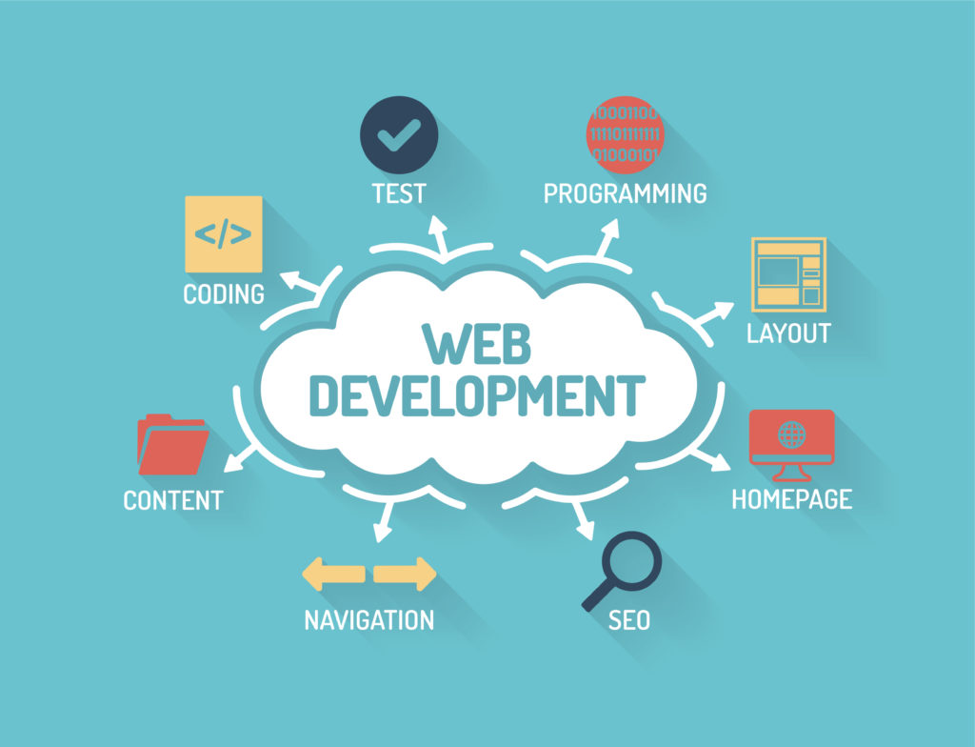
Domain
Web Development
Machine Learning
Web Scraping

Slide 7
Tools and Libraries to be used
Language:
Javascript (web development)
Python (machine learning)
Frameworks
Next.js (React.js) - frontend
Node.js - backend
MongoDB - database
Libraries:
Numpy - data cleaning and reading
Pandas - data cleaning and reading
Scipy - data cleaning and reading
sklearn - machine learning and testing
beautfiulSoup - web scraping
Software:
jupyter-lab
visual studio

Slide 8
Models Used
Support Vector Machines
K Nearest Neighbour
Random Forest
Naive Bayes
Decision Tree

Slide 9
Dataset
http://www2.informatik.uni-freiburg.de/~cziegler/BX/
- Books dataset
- Ratings dataset
- Users dataset
Dynamic dataset for room recommendation

Slide 10
Proposed Methodology
Data cleaning and pre-processing
Web scraping to add required columns
Models for book dataset and room recommendation
Study rooms using web sockets
Frontend and backend using Next.js and Node.js

Slide 11
Advantages
Students or readers with common interests can discuss on a common platform
Access controls will be with the admin to avoid misbehaviour and customize the rooms
Users will get recommendation based on their interests and rooms similar to theirs
No youtube ads while studying, i.e minimal distractions

Slide 12
Limitations
Limit on number of books available for free
Limit on Concurrent Users in a single chat
Videos on Youtube’s Platform / Local Host Drive only.
Room recommendation dataset will become more efficient with the greater number of rooms created

Slide 13
References
https://thesai.org/Downloads/Volume12No1/Paper_26-Personalized_Book_Recommendation_System.pdf
https://www.researchgate.net/publication/360483603_Research_paper_on_Group_chatting_Application
https://github.com/davehowson/chat-app
https://www.adlit.org/books-and-authors/books?text=asdfghj&sort_by=search_api_relevance

Slide 14
Conclusion
Our system enables students to connect globally, pick books of their choice and discuss doubts in a common environment.

Slide 15
Thank You

